Slide 1
Girl’s Health Focus: Iron
What is it and how does it affect me?
Amanda Haney, Dietetic Intern September 2011
Notes:
Today we will be discussing what iron is, the role it plays in our bodies, what it means to be iron deficient, how iron deficiency can affect your health, and how you can make sure you are getting enough iron from your diet.

Slide 2
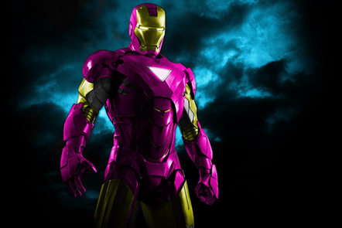
What is Iron?
Iron is a mineral found in the environment and inside our bodies.
Iron is inside of foods we eat everyday
Iron is also in our cells
Ironman isn’t the only one with iron in his body!

Slide 3
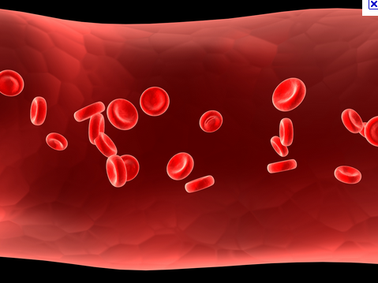
Why is it important?
Iron is part of two important cells in the body called hemoglobin and myoglobin.
Hemoglobin carries oxygen from your lungs to the rest of the body.
Myoglobin carries oxygen to the muscles. Our muscles can not work without oxygen.

Slide 4
What is Iron deficiency?
Iron deficiency is a medical term that means your body does not have enough iron.
When your body is low on iron, hemoglobin and myoglobin cannot do their jobs.
Low iron can make you feel very tired and sick.

Slide 5
When you have low iron…
You can have one or more of these problems:
You feel tired
You feel weak
You are always cold
You have headaches
It is hard to concentrate
You get sick often

Slide 6
Let’s investigate…
Suzy Q feels very tired at school and too weak to play at recess. She is always cold even when it is warm outside. It is hard for her to concentrate in class, and she usually gets a headache during the day.
What could cause these problems for Suzy Q?

Slide 7
Let’s investigate…
Suzy Q feels very tired at school and too weak to play at recess. She is always cold even when it is warm outside. It is hard for her to concentrate in class, and she usually gets a headache during the day.
Iron Deficiency or Low Iron

Slide 8
What if you have low iron?
If you have iron deficiency (low iron) you can get more iron from the foods you eat.
Iron is in many common foods. It is important to remember these foods so you can add them to your diet.

Slide 9
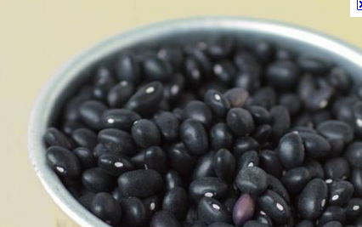
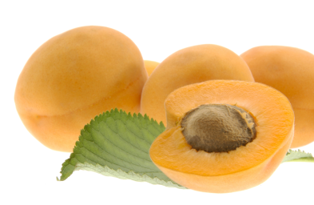
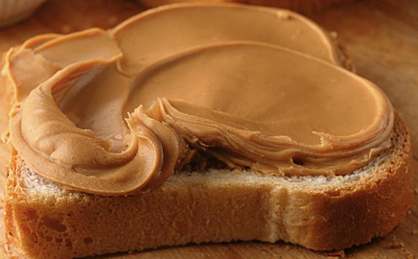
Iron in your food
Baked potato
Beans
Peas
Asparagus
Chicken
Steak
Hamburger
Tuna
Fish
Eggs
Turkey
Spinach
Green leafy vegetables
Raisins
Peanut butter
Oatmeal
Apricots
Eating these foods every day will help your body get the iron it needs!

Slide 10
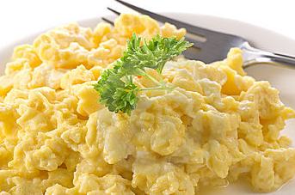
Let’s investigate…
Which breakfast has the most iron?
Scrambled egg with bowl of oatmeal and raisins
Poptart and orange juice
A
B

Slide 11
Let’s play detective…
Which breakfast has the most iron?
Scrambled egg with bowl of oatmeal and raisins
Poptart and orange juice
Eggs, oatmeal, and raisins are all high in iron!!
A
B

Slide 12
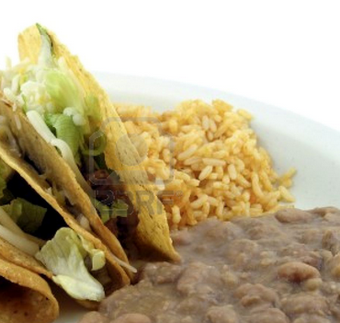
Let’s play detective…
Which lunch has the most iron?
Hamburger with ketchup, cheese, and pickles
Taco with chicken, lettuce, beans, and rice
A
B

Slide 13
Let’s play detective…
Which lunch has the most iron?
Hamburger with ketchup, cheese, and pickles
Taco with chicken, lettuce, beans, and rice
Chicken, beans, and brown rice are all high in iron!!
A
B

Slide 14
How much Iron do I need?
If you are 9-13 years old you need 8mg of Iron each day
If you are 14-18 years old you need 15mg of Iron each day

Slide 15
Iron makes a healthier you!
Students, especially teenage girls, who have low iron score lower on tests.
Getting the iron you need each day will help you think more clearly and do better in school!
Low iron makes you tired, weak, and you may feel sick.
Getting the iron you need each day will help you feel energized, strong, and help you stay healthy!

Slide 16
Discussion
How will you feel if you have low iron?
Why is iron important for your body?
What foods have you eaten today that are high in iron?
What are some foods you like that are high in iron, and how can you add them to your diet?

